Slide 1
BCS202P- Data Structures and Algorithms Lab
Dr. Priyanka N
Assistant Professor Senior Grade 1
School of Computer Science & Engineering
VIT, Vellore.

Slide 2
BCS202P- Data Structures and Algorithms Lab
COURSE OBJECTIVE
1. To impart basic concepts of data structures and algorithms.
2. To differentiate linear, non-linear data structures and their operations.
3. To comprehend the necessity of time complexity in algorithms.

Slide 3
BCS202P- Data Structures and Algorithms Lab
COURSE OUTCOMES
1. Apply appropriate data structures to find solutions to practical problems.
2. Identify suitable algorithms for solving the given problems.

Slide 4
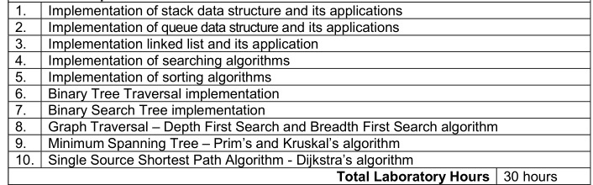
BCS202P- Data Structures and Algorithms Lab - Experiments

Slide 5
BCS202L- Data Structures and Algorithms
Text Books:
Mark A. Weiss, Data Structures & Algorithm Analysis in C++, 4 th Edition, 2013,Pearson Education.
Reference Books:
Alfred V. Aho, Jeffrey D. Ullman and John E. Hopcroft, Data Structures and Algorithms,1983, Pearson Education.
Horowitz, Sahni and S. Anderson-Freed, Fundamentals of Data Structures in C, 2008, 2nd Edition, Universities Press.
Thomas H. Cormen, C.E. Leiserson, R L. Rivest and C. Stein, Introduction to Algorithms, 2009, 3rd Edition, MIT Press.

Slide 6
Basic Terminologies in DS
Data: Data are simply values or sets of values.
Data items: Data items refers to a single unit of values.
Group: Data items that are divided into sub-items are called Group items.
Elementary items: Data items that are not able to divide into sub-items are called Elementary items.
Entity: An entity is something that has certain attributes or properties which may be assigned values. The values may be either numeric or non-numeric.
Field is a single elementary unit of information representing an attribute of an entity.
Record is the collection of field values of a given entity.
File is the collection of records of the entities in a given entity set.

Slide 7
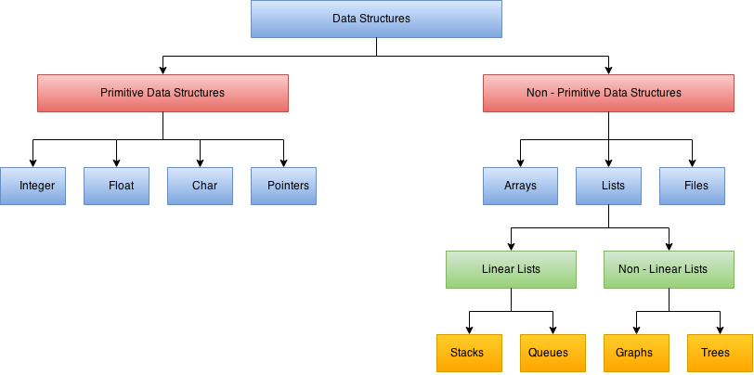

Slide 8
Implementation of Searching Algorithm
Linear Search
Linear search is a very simple search algorithm. In this type of search, a sequential search is made over all items one by one. Every item is checked and if a match is found then that particular item is returned, otherwise the search continues till the end of the data collection.

Slide 9
Linear search( array[], search element)
{
for i=1 to n do
{
if( array[i]==search element)
{
return i;
}
}
return 0;
}

Slide 10
Binary Search
Binary search is a fast search algorithm works on the principle of divide and conquer,
Data should be compulsory in the sorted form

Slide 11
How Binary Search Works?
Binary search looks for a particular item by comparing the middle most item of the collection. If a match occurs, then the index of item is returned.
If the middle item is greater than the item, then the item is searched in the sub-array to the left of the middle item.
Otherwise, the item is searched for in the sub-array to the right of the middle item. This process continues on the sub-array as well until the size of the subarray reduces to zero.

Slide 12
Binary search( array[], x, Low, high, mid)
{
Low=1, high=n;
While(low<=high)
{
mid=(low+high)/2;// Finding mid value
if(x==a[mid])
return mid;
else if(x<a[mid])
high=mid-1;
else
low=mid+1;
}
return 0;
}

Slide 13

How Binary Search Works?
For a binary search to work, it is mandatory for the target array to be sorted.
Example:
The following is our sorted array and let us assume that we need to search the location of value 31 using binary search.

Slide 14
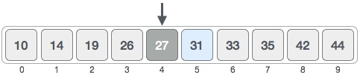
Binary Search
First, we shall determine half of the array by using this formula −
mid = (low + high) / 2
Here it is, (0 + 9)/ 2 = 4 (integer value of 4.5).
So, 4 is the mid of the array.

Slide 15

Binary Search
Now we compare the value stored at location 4, with the value being searched, i.e. 31.
We find that the value at location 4 is 27, which is not a match.
As the value is greater than 27 and we have a sorted array, so we also know that the target value must be in the upper portion of the array.

Slide 16
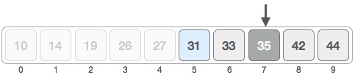
Binary Search
We change our low to mid + 1 and find the new mid value again.
low = mid + 1
High = remains same
mid = (low + high) / 2
Low=4+1=5; mid=(5+9)/2=7
Our new mid is 7 now. We compare the value stored at location 7 with our target value 31.

Slide 17

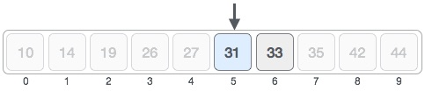
The value stored at location 7 is not a match, rather it is more than what we are looking for. So, the value must be in the lower part from this location.
Hence, we calculate the mid again. This time it is 5.

Slide 18

Binary Search
We compare the value stored at location 5 with our target value. We find that it is a match.
We conclude that the target value 31 is stored at location 5.
Binary search halves the searchable items and thus reduces the count of comparisons to be made to very less numbers.

Slide 19
Visualization of Linear and Binary Search
https://www.cs.usfca.edu/~galles/visualization/Search.html

